Slide 1

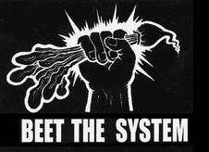
Food Justice Primer
OKTjustice.org

Slide 2
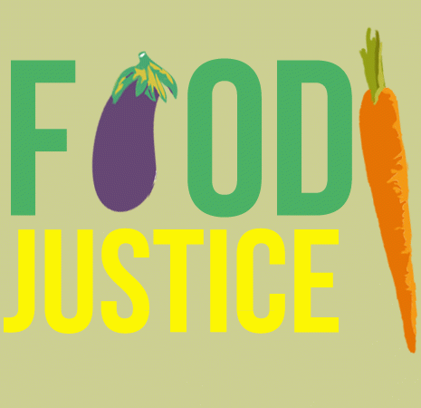
Food Justice
Definitions:
seeks to ensure that the benefits and risks of where, what, and how food is grown, produced,
transported, distributed, accessed and eaten
are shared fairly.

Slide 3
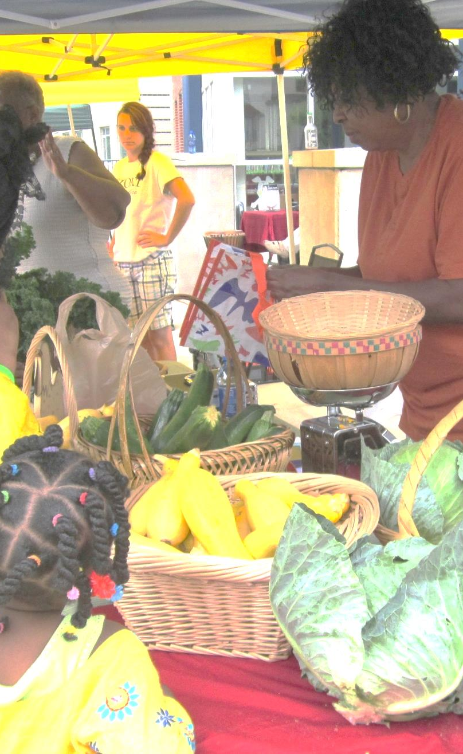
Food Justice
Definitions:
represents a transformation of the current food system, including eliminating disparities and inequities.

Slide 4
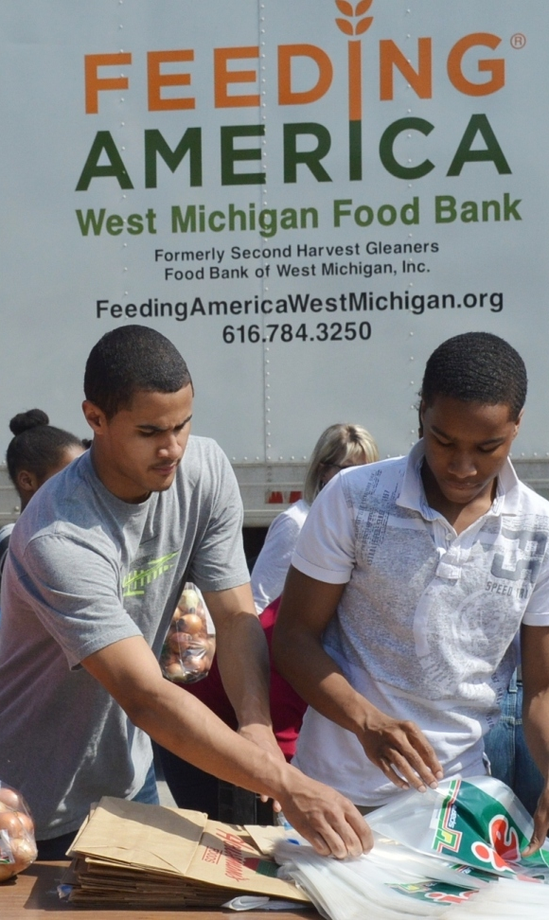
Food Justice?
Definitions:
Food banks and food charity are not food justice. They are important but do not address the causes of food insecurity.

Slide 5
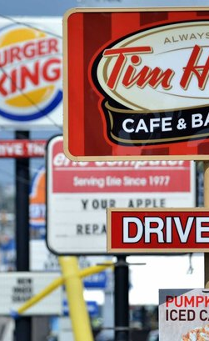
Food Insecurity
Definitions:
You cannot get healthy foods.

Slide 6
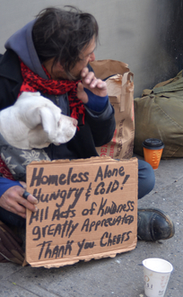
Definitions:
Food Insecurity
You cannot store or prepare healthy foods.

Slide 7
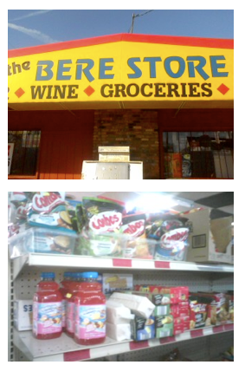
Food Insecurity
Definitions:
As depicted foods available in your neighborhood are junk foods or fast foods.

Slide 8
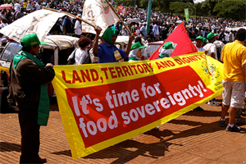
Food Sovereignty
Definitions:
People determine the kind of food system they want, as long as it is ecologically sustainable.
http://viacampesina.org/en/index.php/main-issues-mainmenu-27/food-sovereignty-and-trade-mainmenu-38
https://vimeo.com/27473286

Slide 9
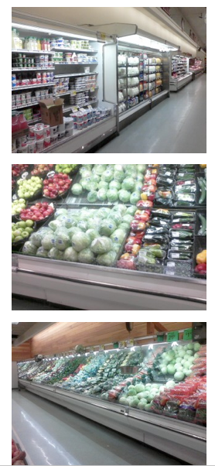
Food Desert
Definitions:
Neighborhoods with little or no access to large grocery stores that offer fresh and affordable foods.
Is this a good term?
Notes:
A desert is a vibrant ecosystem
grocery stores are not a measure of food security.
It overlooks intentional political and historical factors that have limited availability of healthy food in certain neighborhoods.

Slide 10
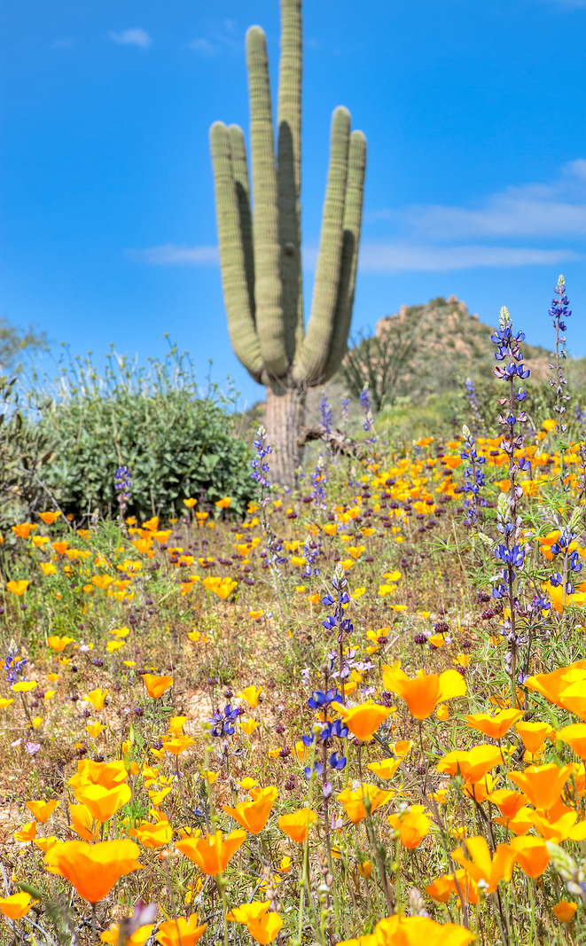
Food Desert?
A desert is a vibrant ecosystem.
Grocery stores are not a measure of food security.
Intentional political and historical factors limit availability of healthy food in certain neighborhoods.

Slide 11
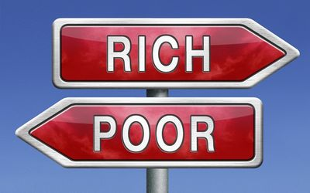
Food Desert?
Definitions:
No.
A more accurate term:
Food Apartheid.
Notes:
A desert is a vibrant ecosystem
grocery stores are not a measure of food security.
It overlooks intentional political and historical factors that have limited availability of healthy food in certain neighborhoods.

Slide 12
Food Apartheid:
Definitions:
The intentional, systematic marketing and distribution of profitable, nutrient-poor, disease-causing foods to neighborhoods experiencing income challenges, mainly, communities of color (i.e. communities receiving the most food assistance dollars).
Notes:
A desert is a vibrant ecosystem
grocery stores are not a measure of food security.
It overlooks intentional political and historical factors that have limited availability of healthy food in certain neighborhoods.

Slide 13
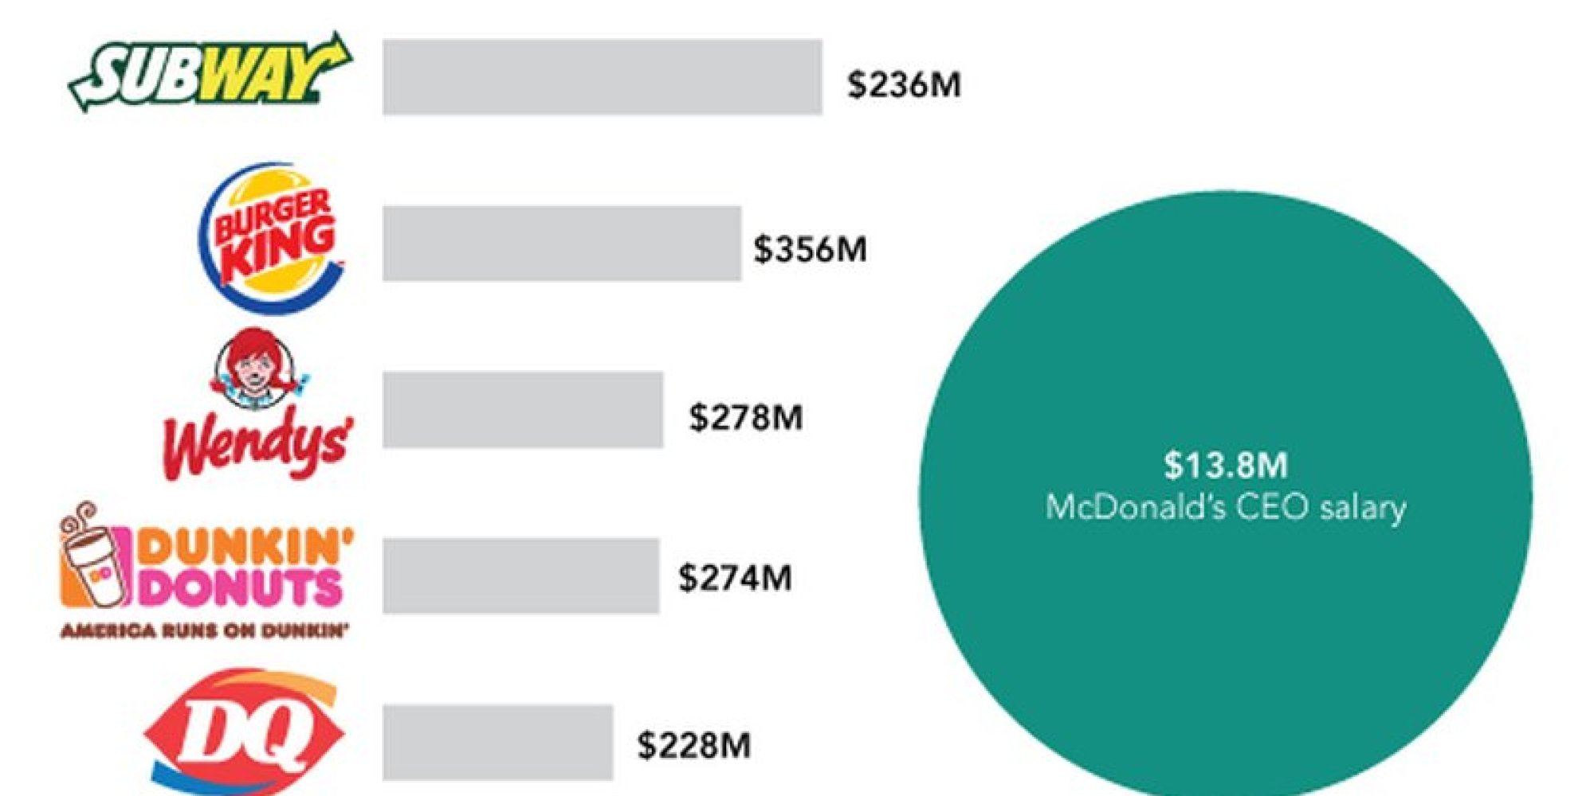
Why Do Our Neighborhoods Experience Food Apartheid?
It's profitable for the food industry.

Slide 14
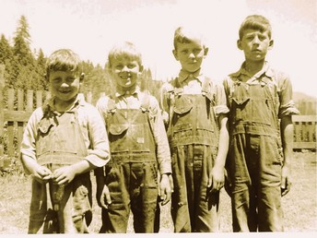
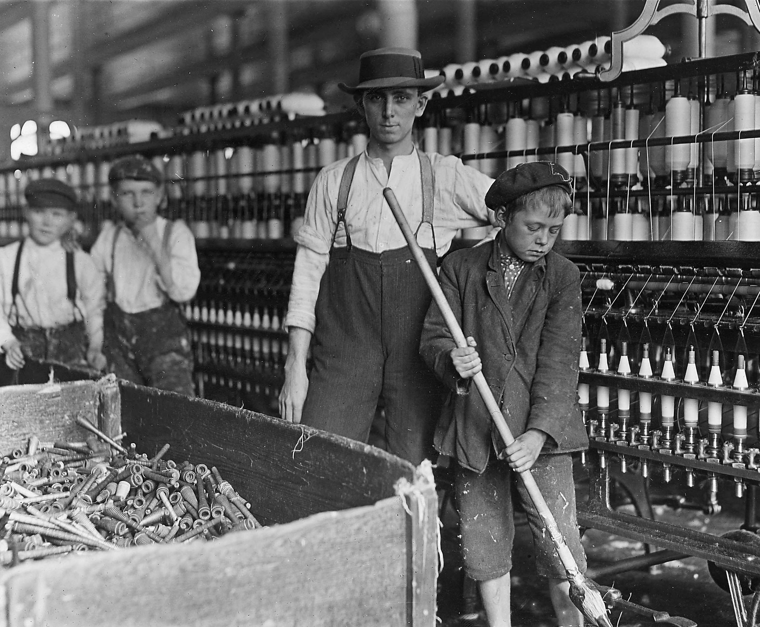
How we got the food system we have.
Industrial capitalism moved people from rural to urban spaces. As fewer people grew their own food, the industrial food system gained control of food production.
Notes:
Upton Sinclair’s The Jungle

Slide 15
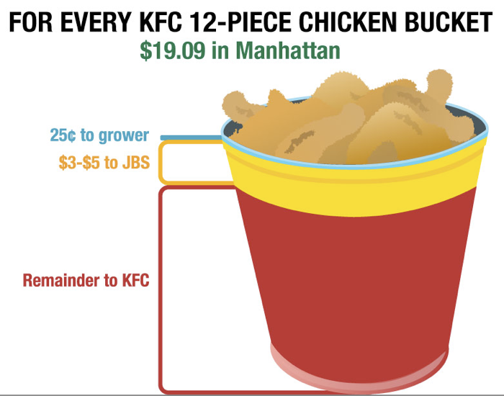
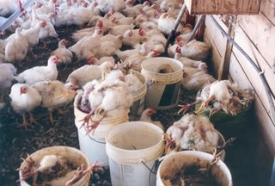
How we got the food system we have.
To increase profit, the Industrial Food System has historically exploited workers and brutalized animals.
Notes:
Upton Sinclair’s The Jungle

Slide 16
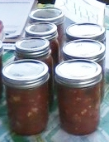
How we got the food system we have.
Instead of relying on home-preserved and seasonal foods, people began to rely on industrial preserved foods and refrigeration.

Slide 17
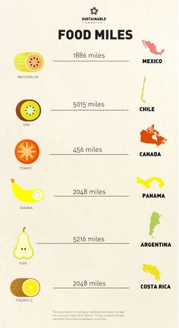
How we got the food system we have.
Transportation systems and refrigeration allowed food to travel thousands of miles from where it is grown and/or processed. Chemicals extend shelf-life.
Notes:
http://www.cuesa.org/page/how-far-does-your-food-travel-get-your-plate.

Slide 18
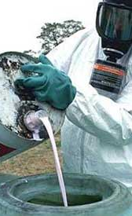
How we got the food system we have.
Chemicals and fossil fuel fertilizers came to dominate agriculture production after WWII.
http://www.texascenter.org/almanac/Land/PESTICIDESP1.HTML

Slide 19
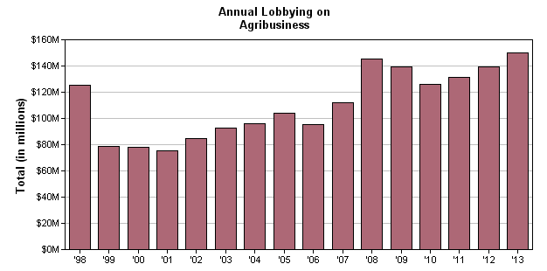
In Government

Slide 20
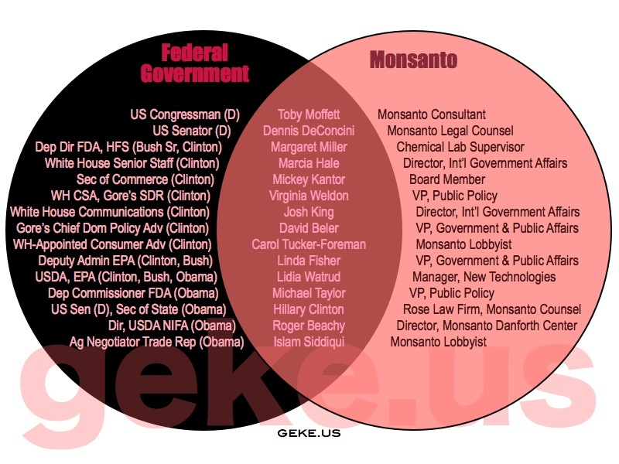
In Government
Corporate Influencers

Slide 21
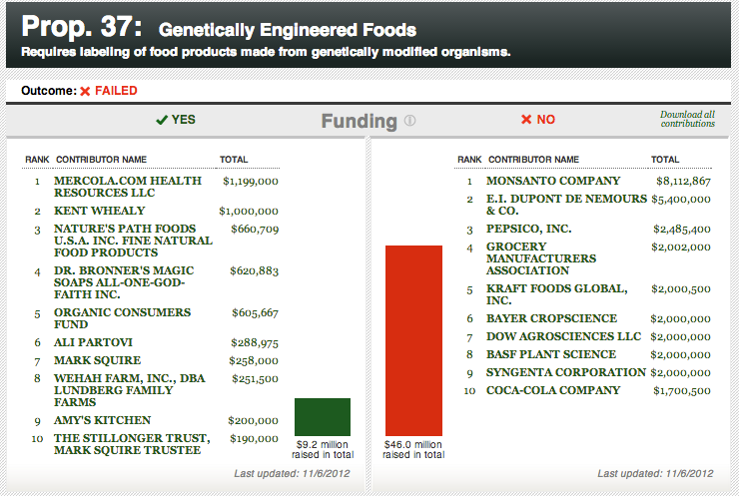
In Government
Corporate Influencers

Slide 22
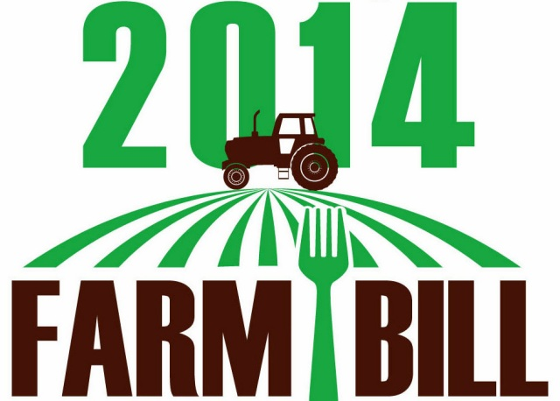
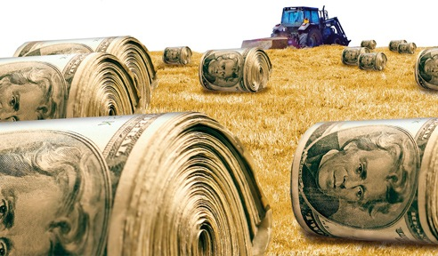
In Government
Corporate Influencers
Farm Subsidies
1995-2011
Nationally
$277.3 billion
Michigan
$4.61 billion
http://farm.ewg.org/region.php?fips=26000
￼

Slide 23
In Government
Corporate Influencers
2014 Farm Bill
Gave $956 billion to agribusiness.
Cut $8.6 billion from
food assistance programs.
￼

Slide 24
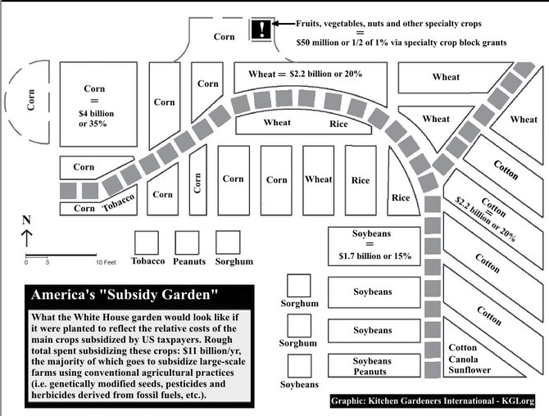
Corporate Influencers
In Government
Notes:
Add a slide of container ho do vve pratcie food justice

Slide 25
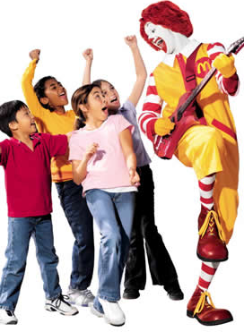

In the Media
Corporate Influencers
$100 Billion+ in advertising dollars spent in the US annually.
$1.8 billion target children with unhealthy foods: TV, product placement, online, phones, school events & materials etc.

Slide 26
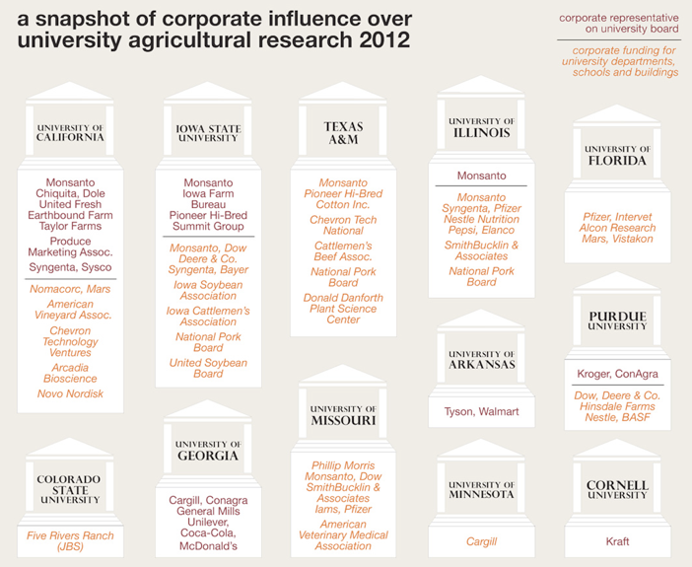
Corporate Influencers
In schools and universities

Slide 27
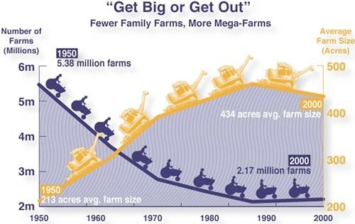
Corporate Influencers
Monopolization of food production.

Slide 28
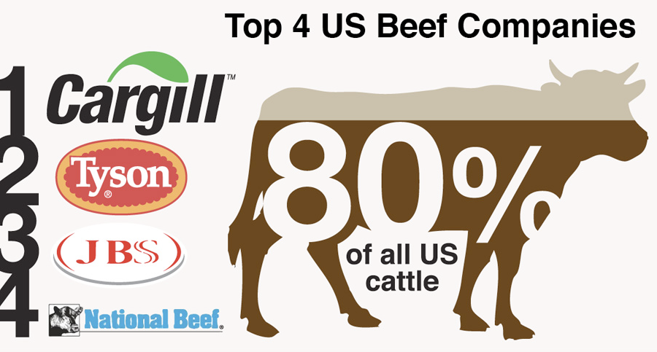
Corporate Influencers
Monopolization of food production.

Slide 29
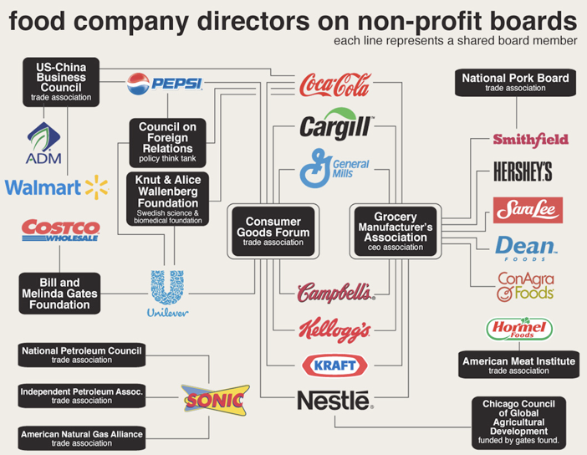
Corporate Influencers
On Non-profits.

Slide 30

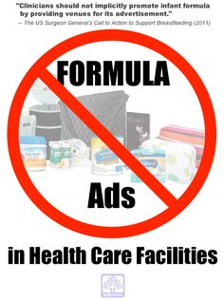
Corporate Influencers
On Healthcare.
http://www.eatdrinkpolitics.com/wp-content/uploads/AND_Corporate_Sponsorship_Report.pdf

Slide 31
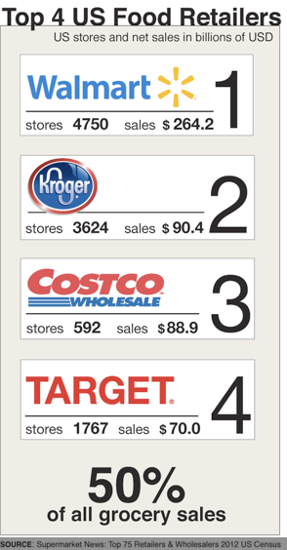
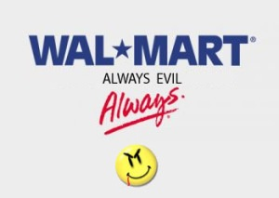
Monopolization of food distribution.
Corporate Influencers
http://www.walmartsubsidywatch.org/

Slide 32
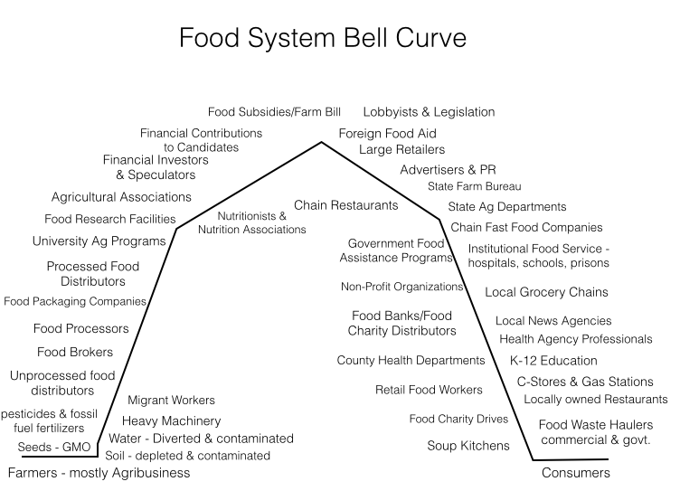
Corporate Influencers

Slide 33
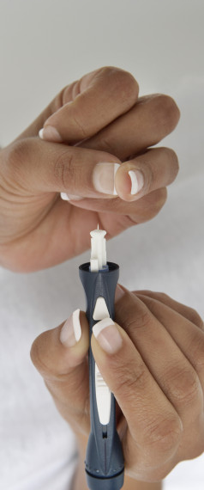
On our health:
Corporate Influencers
Obesity
High blood pressure
Heart disease
Cancer
Insurance costs
Poor Health

Slide 34
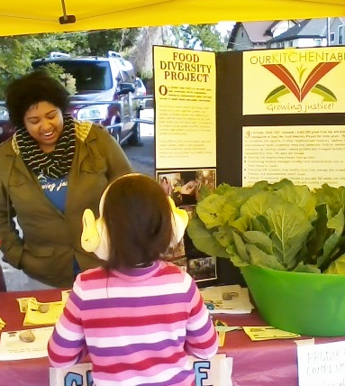
Food Justice
Definitions:
“Food Justice asserts that food is a right and no one should live without enough food because of economic constraints or social inequalities. Food justice reframes the lack of healthy food sources in poor communities as a human rights issue.”
www.growingfoodandjustice.org

Slide 35
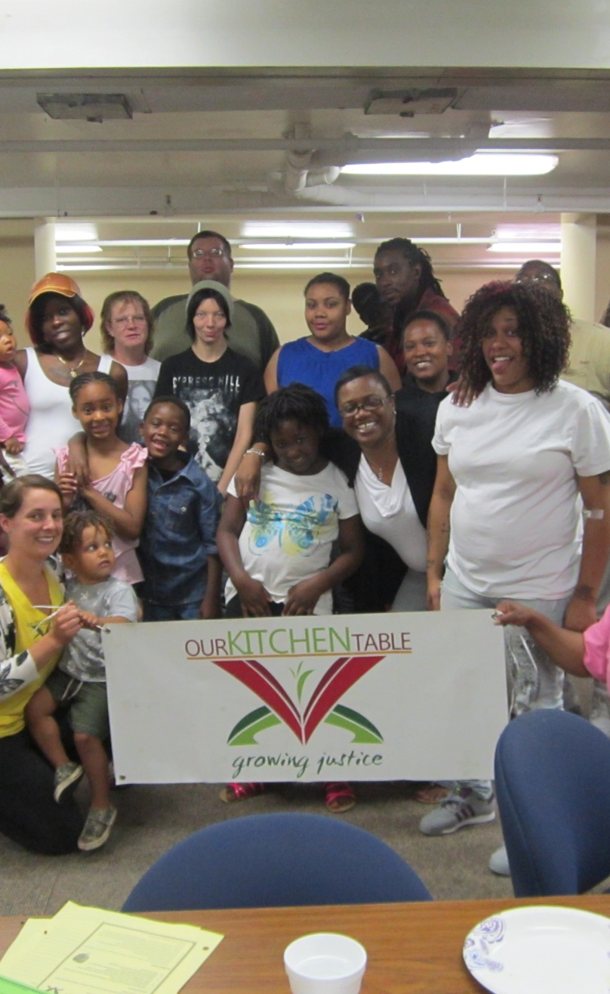
7 Pillars of Food Justice
1.
Everyone has a RIGHT to healthy food.

Slide 36
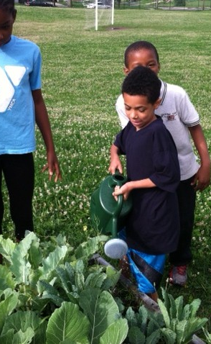
2.
7 Pillars of Food Justice
We must build a new global food system and "hospice out" the old.

Slide 37
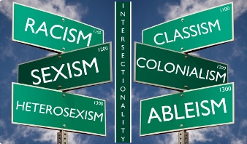
3.
7 Pillars of Food Justice
Because multiple systems of oppression prevent food justice, we must do the work through an intersectional lens.

Slide 38
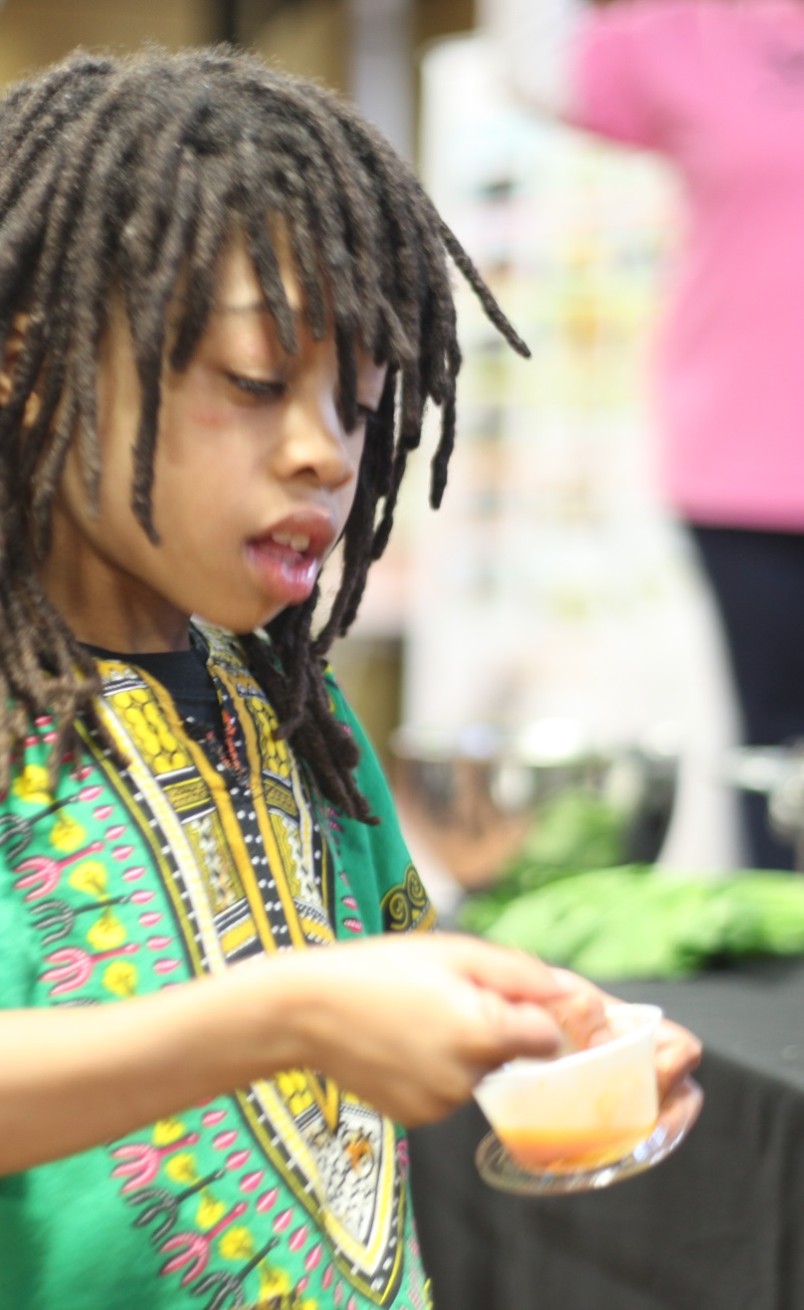
4.
7 Pillars of Food Justice
Food Justice work focuses on marginalized
and vulnerable populations.

Slide 39
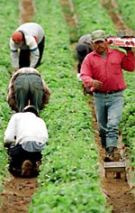
5.
Food Justice works to eliminate exploitation of humans and animals.

Slide 40
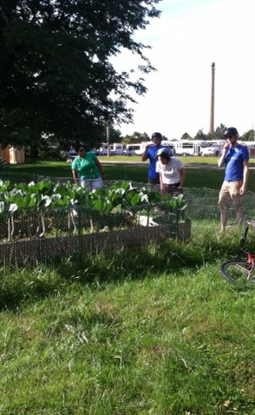
6.
Food Justice preserves ecological biodiversity and promotes sustainability.

Slide 41
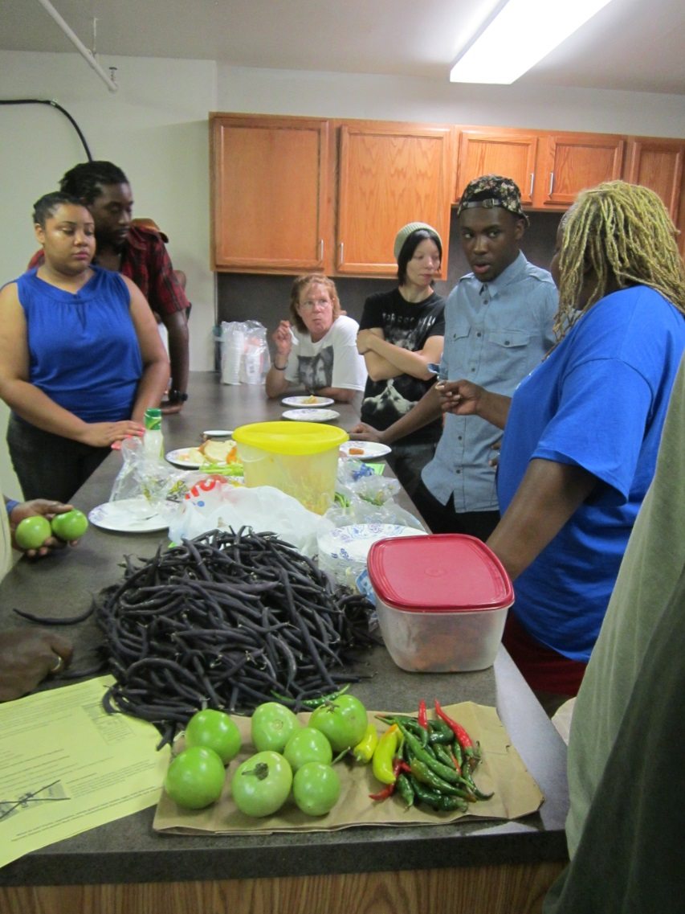
7.
Food Justice means sharing resources and skills that empower people
to be more
food self-sufficient.

Slide 42
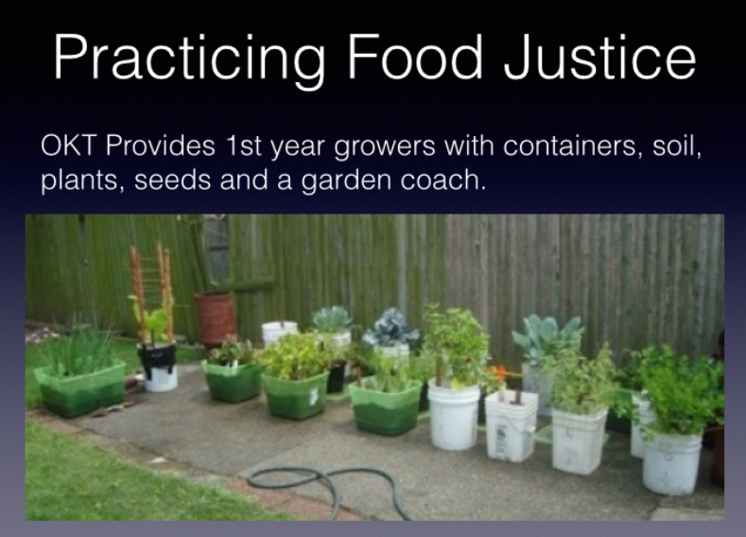

Slide 43
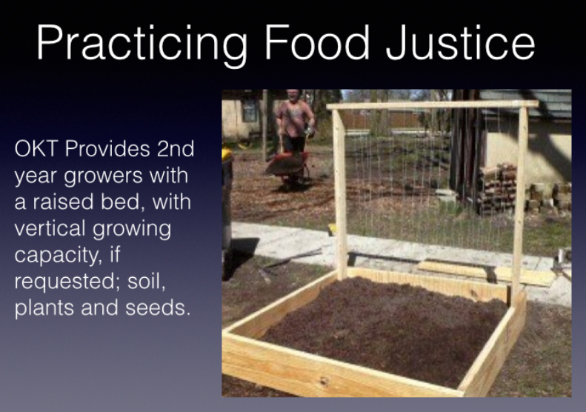

Slide 44
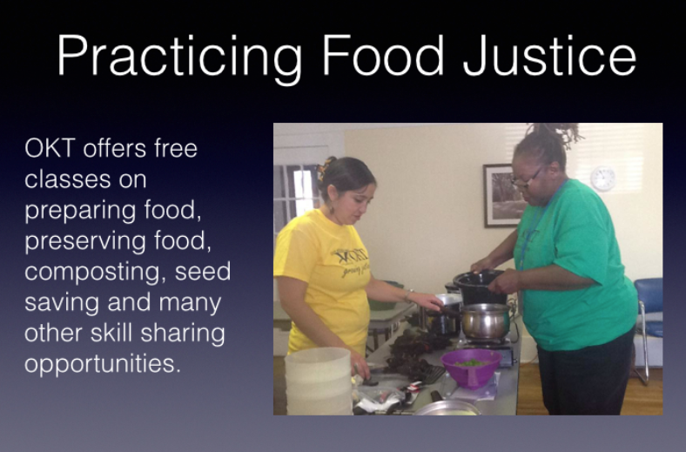

Slide 45
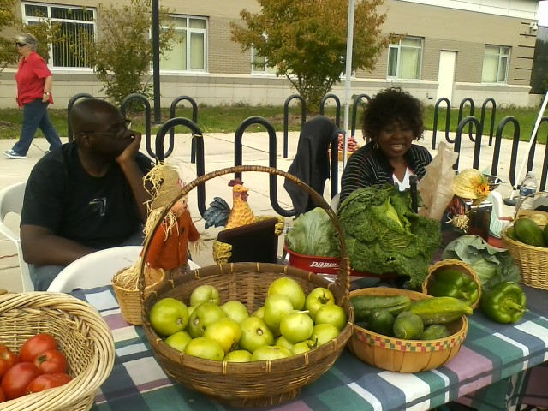
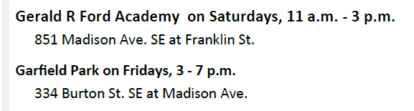



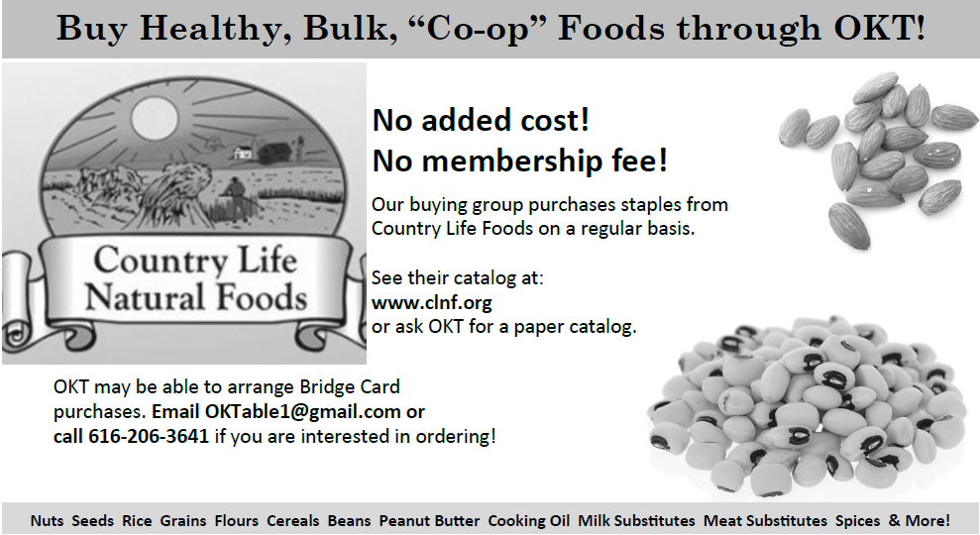
Practicing Food Justice
Southeast Area Farmers’ Market
Bulk Food Buying Group

Slide 46
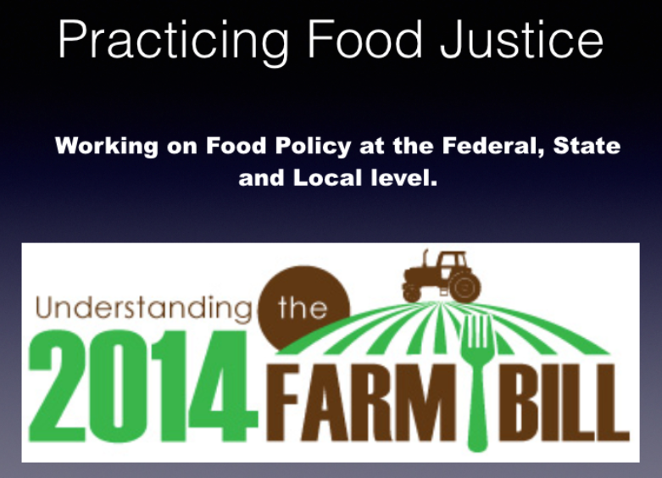




Slide 47

Practicing Food Justice

Slide 48

Resources
Food First http://www.foodfirst.org/
Food & Water Watch http://www.foodandwaterwatch.org/
Organic Consumers Association http://www.organicconsumers.org/
Via Campesina http://viacampesina.org/en/
Navdanya http://www.navdanya.org/
http://www.justfood.org/food-justice
http://www.albafarmers.org/
http://www.agriculturaljusticeproject.org/home.html
http://casfs.ucsc.edu/
http://www.ciw-online.org/
http://www.growingpower.org/
http://knowwhereyourfoodcomesfrom.com/
http://immigrantfarming.org/
http://www.nuestras-raices.org/
http://www.panna.org/
http://www.nativeharvest.com/

Slide 49

Resources
OKT Food Justice Series
The Farm Bill
What Is Food Justice?
Women of Color &Food Justice
Food Workers & a Living Wage
Food Justice & Climate Change
Food Justice & GMOs
Food Justice & Farmers’ Markets
Food Justice & Public Health
How to Save Seeds
Politics of Food
OKT offers these hand-outs copy-right free
at no charge at http://oktjustice.org/resources/okt-food-justice-series/

