Slide 1

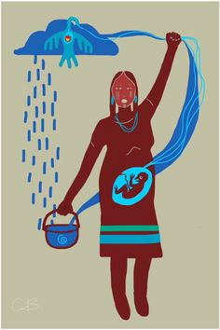
Water Justice
A Fundamental Human Right.

Slide 2
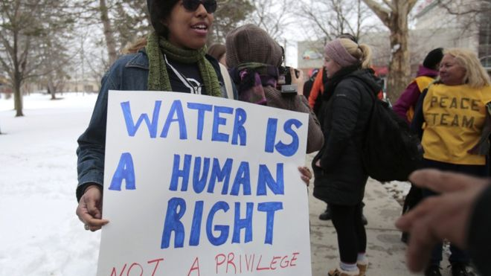
Flint
A Civil Rights Infraction

Slide 3
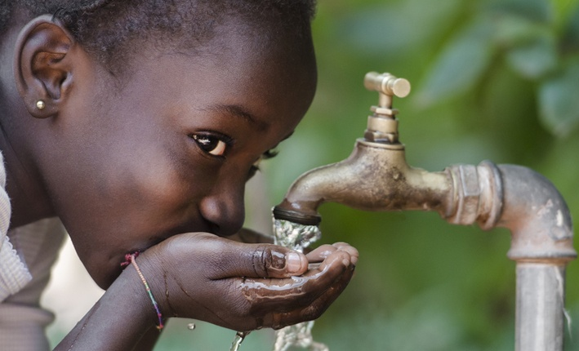
Emergency Financial Manager
Bottled Water
When will residents have clean water again?

Slide 4
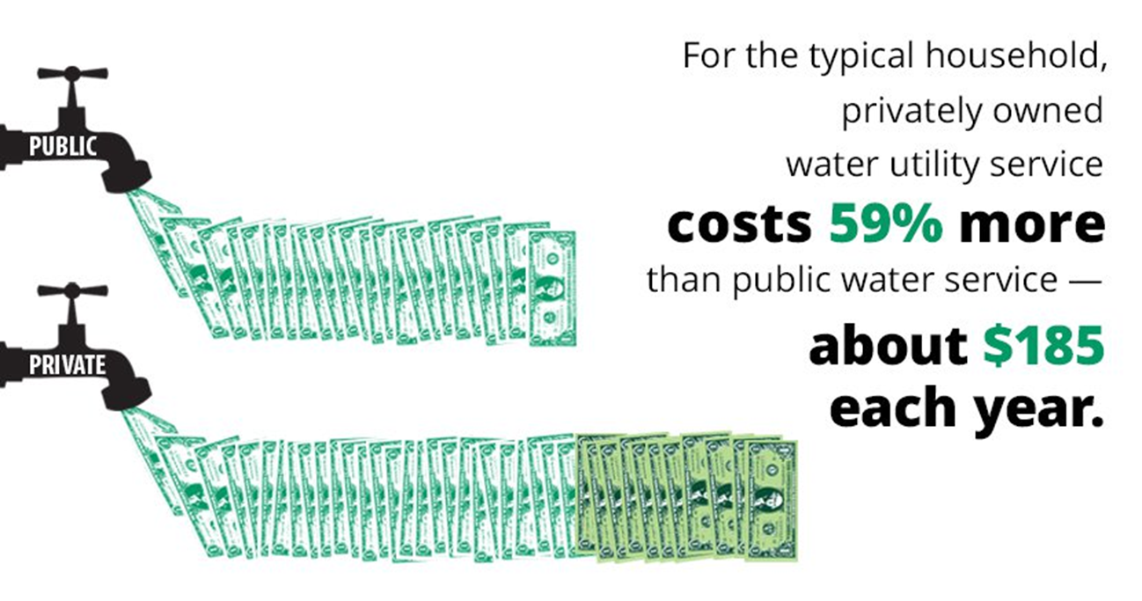
Privitization

Slide 5
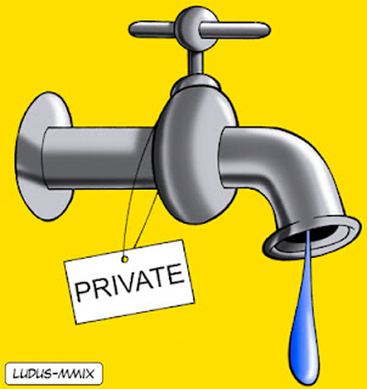
Privitization results in:
· Loss of Control.
· Loss of public input.
· Loss of transparency.
· For profit, not public interest.
· Cherry picking service areas.
· Rate Increases.
· Service Problems.
· Loss of one in three water jobs.
· Privatization can allow systems to deteriorate.

Slide 6
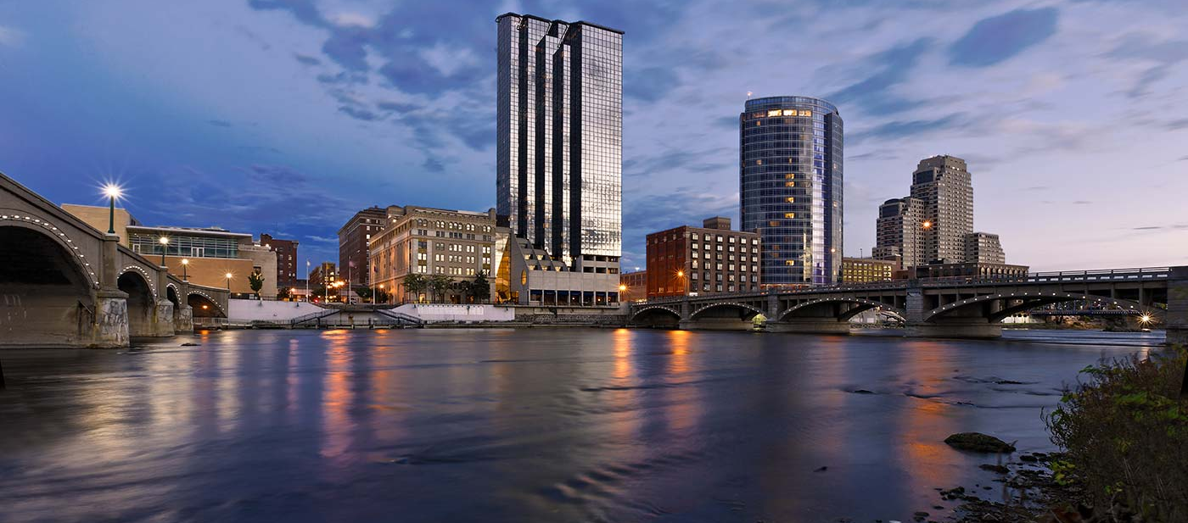
In 2011, the City of Grand Rapids considered privatizing its water. Thankfully, Mayor Heartwell declined.

Slide 7
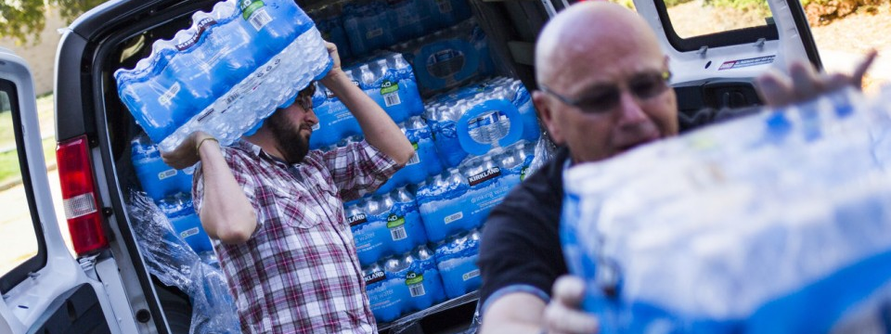
Bottled water.
Solution or a cause?

Slide 8
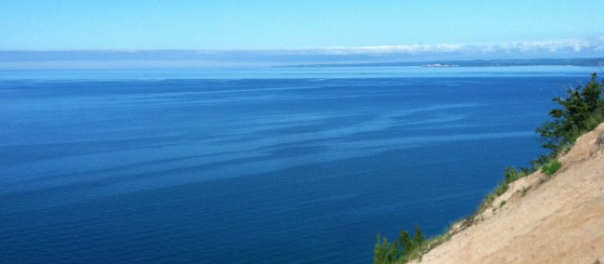
Nestle: 400 gallons per minute. $13 million in tax breaks.

Slide 9
Standing Rock
#NODAPL

Slide 10

Donate
Michigan Host Tent
GoFundMe Campaign
https://www.gofundme.com/www-facebook-com-michigan-host-tent-at-standing-rock-9971858

Slide 11
Call
Executives of Energy Transfer Partners, the corporation that is building the pipeline:
Lee Hanse, EVP, (210) 403-6455, Lee.Hanse@energytransfer.com
Glenn Emery, VP, (210) 403-6762, Glenn.Emery@energytransfer.com
Michael (Cliff) Waters, Lead Analyst, (713) 989-2404, Michael.Waters@energytransfer.com

Slide 12
Call
· North Dakota Gov. Jack Dalrymple at (701) 328-2200 to demand protections for protestors and end to hostilities against them.
· The White House at (202) 456-1111 or (202) 456-1414. Tell President Obama to rescind the Army Corps of Engineers’ Permit for the Dakota Access Pipeline.
· The Army Corps of Engineers and demand that they reverse the permit for DAPL: (202) 761-5903

Slide 13
Petition
Sign the petition to the White House to Stop DAPL, or sign the petition directed specifically to President Obama

Slide 14
Social Media
Share updates on FACEBOOK, Twitter, Instagram.
Mainstream media is barely covering the facts.
Real journalists covering event are being arrested.

Slide 15
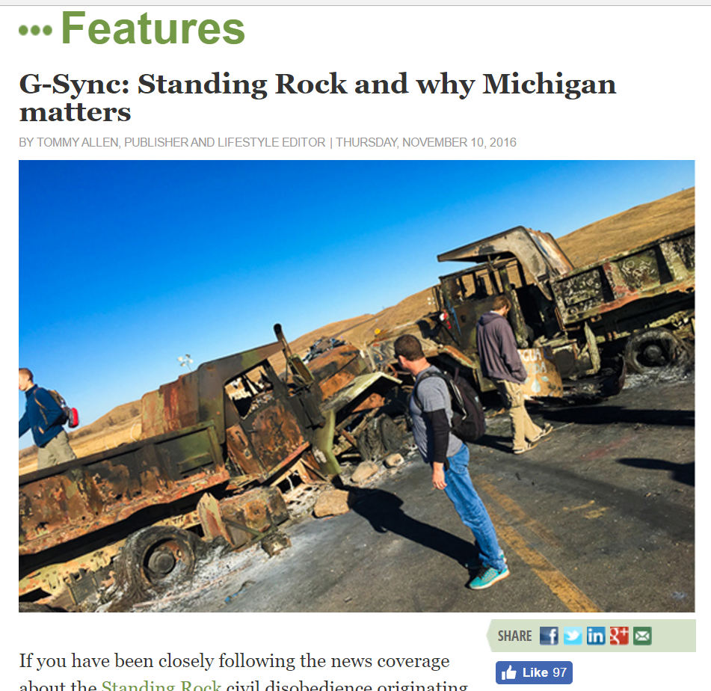
Rapid Growth Media

Slide 16

Take action:
1. Ensure that our tap water is safe to drink and bathe in. This includes employing more reliable testing measures for lead content.

Slide 17
Take action:
2. Reconsider fluoridating our water supply as fluoride has been associated with health risks. Let people choose for themselves whether or not to
ingest fluoride.

Slide 18
Take action:
3. Decline from considering privatizing our municipal water supplies.

Slide 19
Take action:
4. Call for the end of giving Michigan’s water away to Nestle and other bottled water corporations.

Slide 20
Take action:
5. Stop cutting off water service to households with delinquent water bills and cease from using liens from unpaid water bills as a means of seizing property from homeowners.

Slide 21
OKTjustice.org
media@OKTjustice.org
616-206-3641

