Slide 1
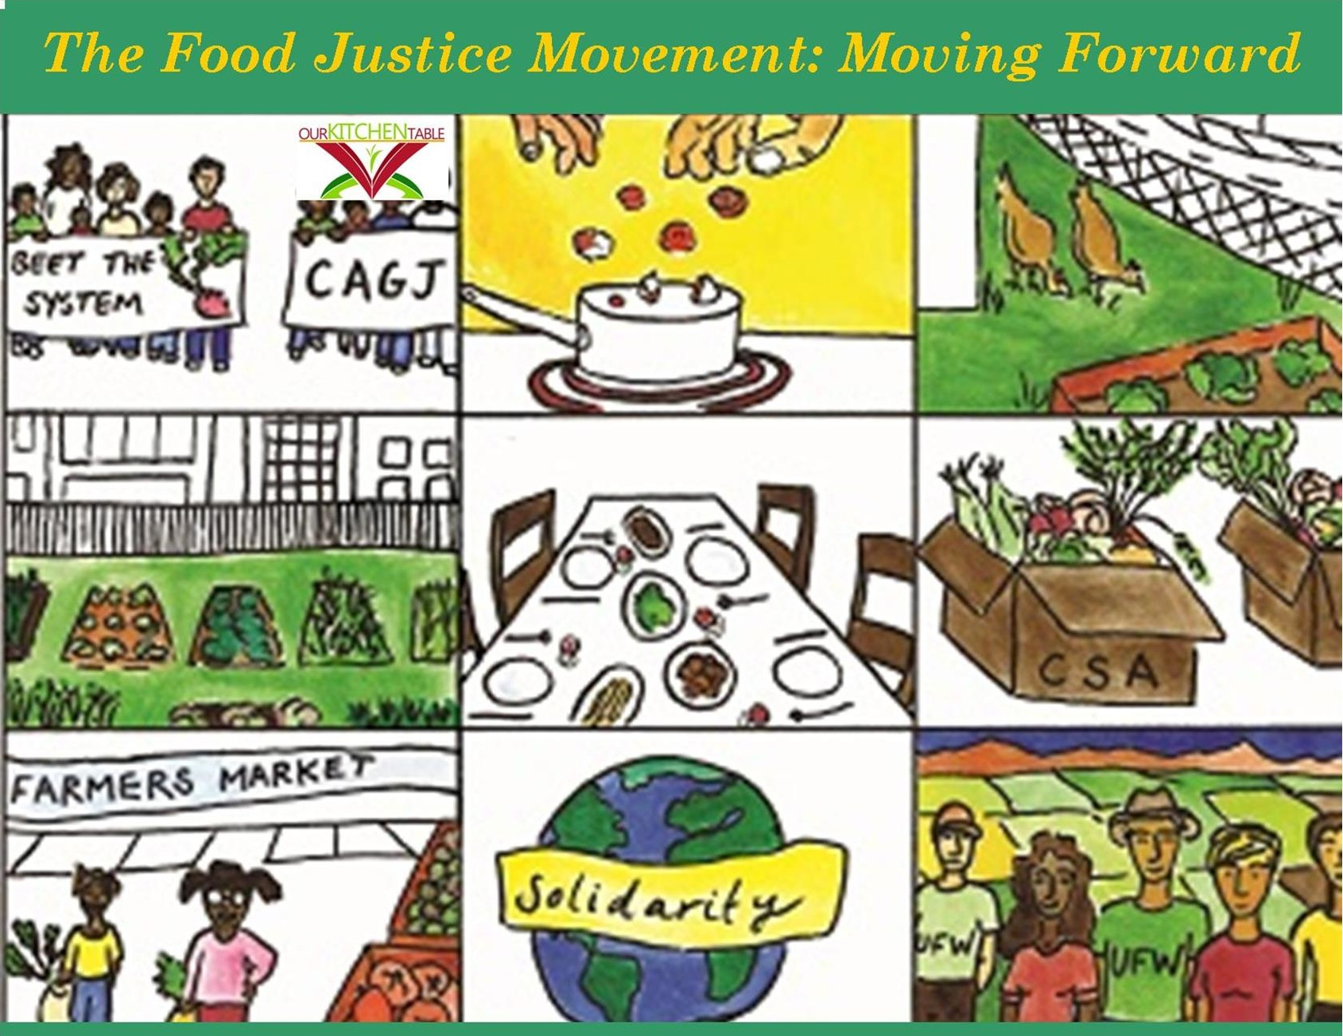
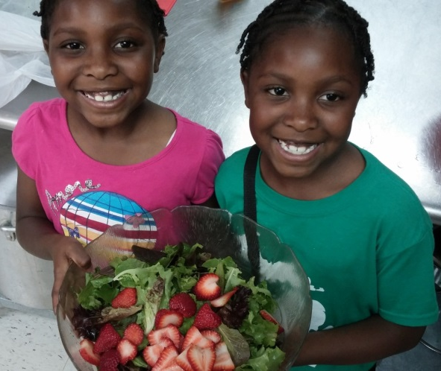

The
Food Justice Movement: Moving Forward
OKTjustice.org

Slide 2

Week 1:
Defining food justice and food sovereignty–
what does it all mean?

Slide 3

Week 1
What is food justice?
What is food insecurity?
A food desert? Or food apartheid?
What is food sovereignty?

Slide 4
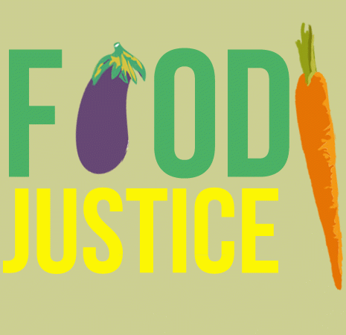
What is
Food Justice?
Definitions

Slide 5
Food justice is the right of communities everywhere to produce, process, distribute, access, and eat good food regardless of race, class, gender, ethnicity, citizenship, ability, religion, or community.
P. 17, Our Food, Our Right.
Definitions

Slide 6
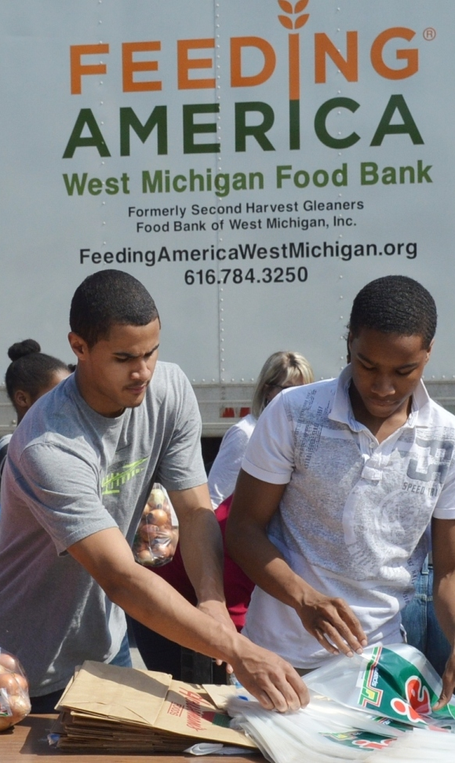
Food Justice?
Definitions
Food pantries and food charity are important but are not food justice because they do not address the causes of food insecurity.

Slide 7
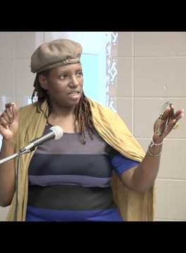

La Donna Redmond
Food + Justice = Democracy
https://www.youtube.com/watch?v=ydZfSuz-Hu8

Slide 8
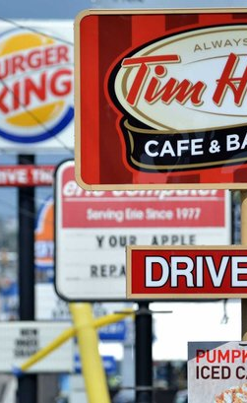
What Is
Food Insecurity?
Definitions

Slide 9
Food Insecurity
Definitions
1. You cannot get healthy foods.

Slide 10
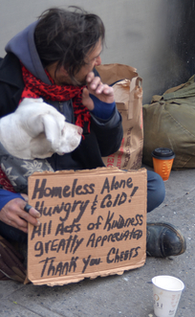
Definitions
Food Insecurity
2. You cannot store or prepare healthy foods.

Slide 11
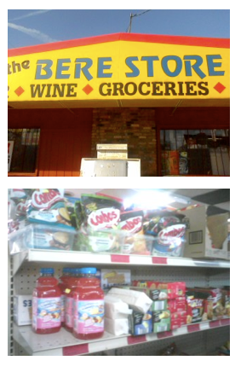
Food Insecurity
Definitions
3. Only junk and fast foods are available in your neighborhood.

Slide 12
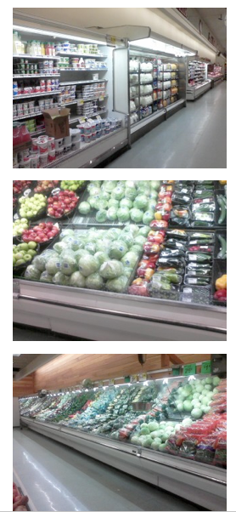
Food Desert
Definitions
Neighborhoods without access to grocery stores that offer fresh, affordable foods.
Is this a good term?
Notes:
A desert is a vibrant ecosystem
grocery stores are not a measure of food security.
It overlooks intentional political and historical factors that have limited availability of healthy food in certain neighborhoods.

Slide 13
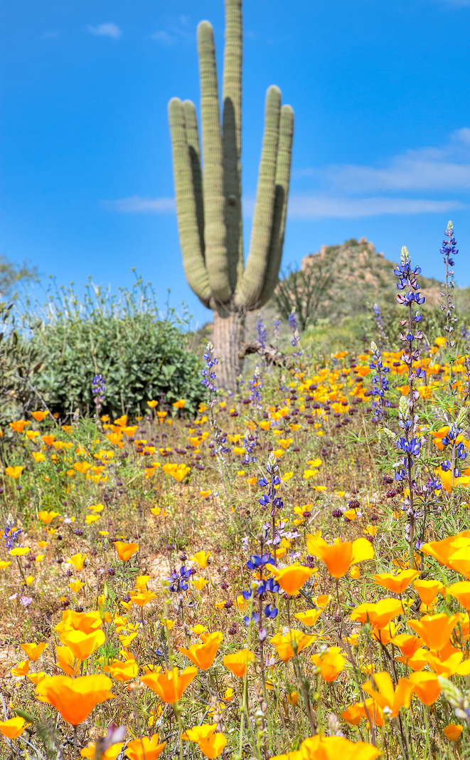
Food Desert?
Definitions
A desert is a vibrant ecosystem.

Slide 14
Food Desert?
Definitions
Grocery stores are not a measure of food security.

Slide 15
Food Desert?
Definitions
Intentionality not an accident.

Slide 16
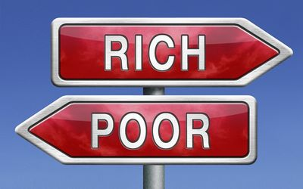
Food Desert?
Definitions
Nope – it’s
Food Apartheid.
Notes:
A desert is a vibrant ecosystem
grocery stores are not a measure of food security.
It overlooks intentional political and historical factors that have limited availability of healthy food in certain neighborhoods.

Slide 17
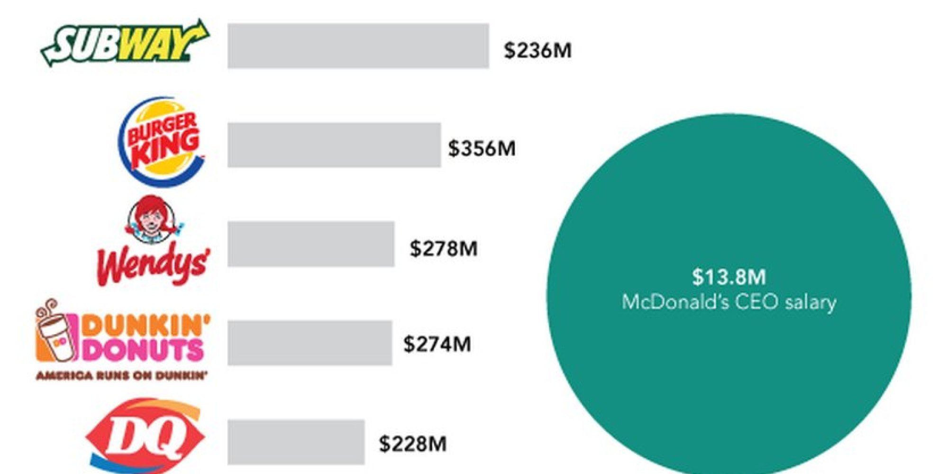
Why Do Our Neighborhoods Experience Food Apartheid?
It's profitable for the food industry.
Definitions

Slide 18
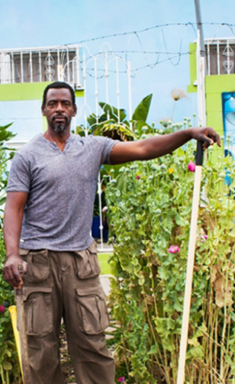
Ron
Finley
Guerilla Gardening
http://www.ted.com/talks/ron_finley_a_guerilla_gardener_in_south_central_la?language=en

Slide 19
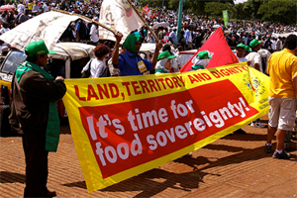
What is Food Sovereignty?
Definitions

Slide 20
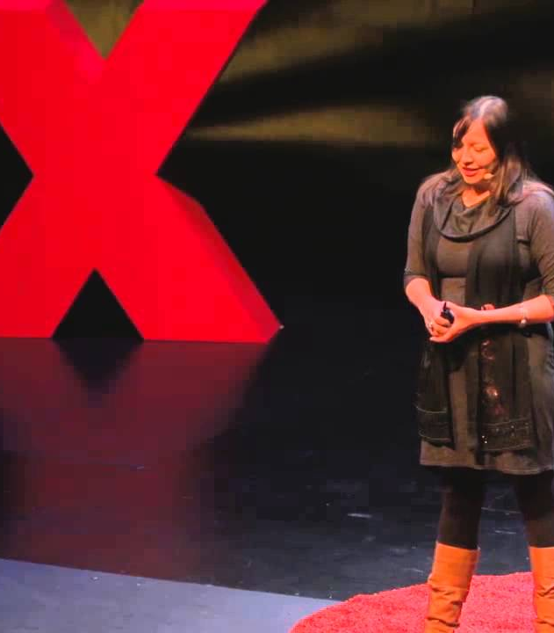
Food Sovereignty
Definitions
People determine the kind of food system they want, as long as it is ecologically sustainable.
https://www.youtube.com/watch?v=RGkWI7c74oo

Slide 21
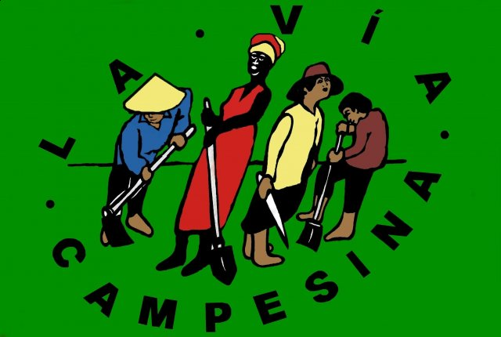
Definitions
Via Campesina’s Food Sovereignty Principles
ONE: Food: A Basic Human Right. Everyone must have access …

Slide 22
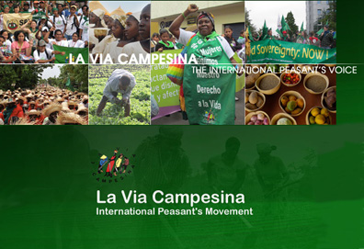
Definitions
Via Campesina’s Food Sovereignty Principles
www.viacampesina.org
2. Agrarian Reform
… the land belongs to those who work it.

Slide 23
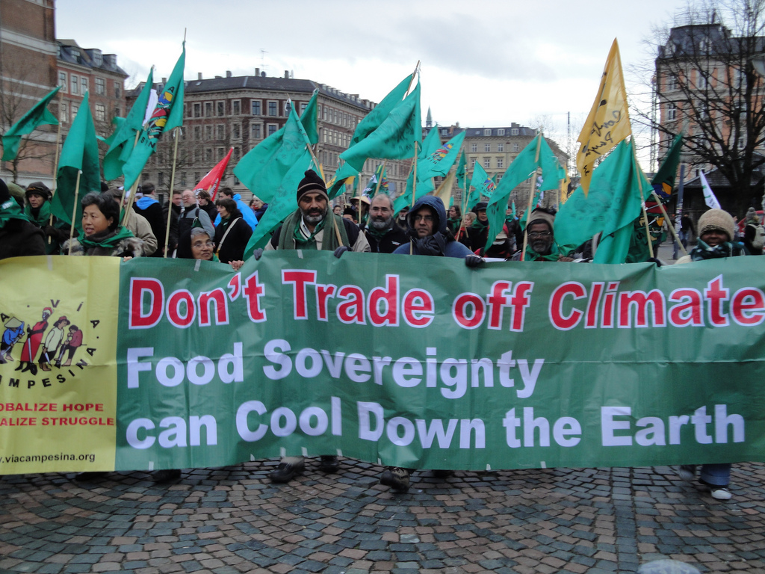
Definitions
3. Protecting Natural Resources
… sustainable care and use of natural resources.

Slide 24
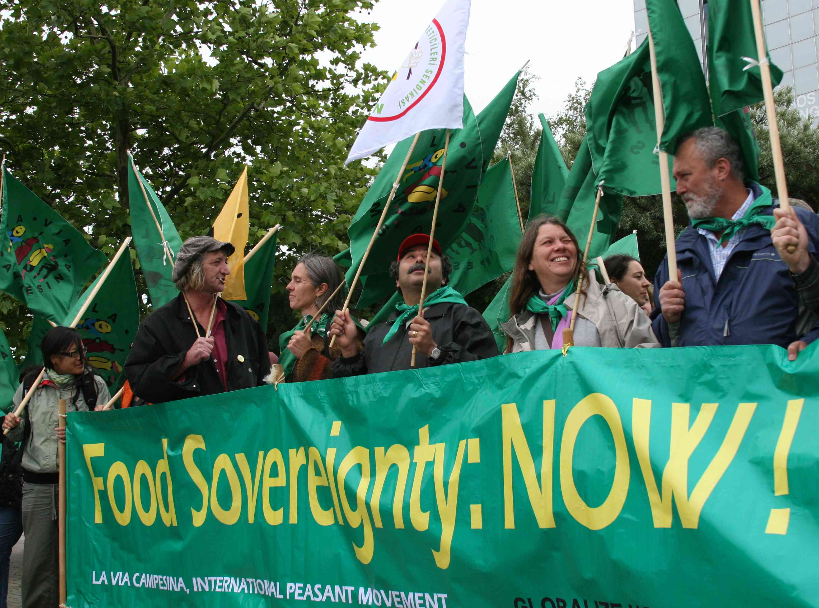
Definitions
Via Campesina’s Food Sovereignty Principles
www.viacampesina.org
4. Reorganizing Food Trade Food
… Food imports must not displace local production nor depress prices.

Slide 25
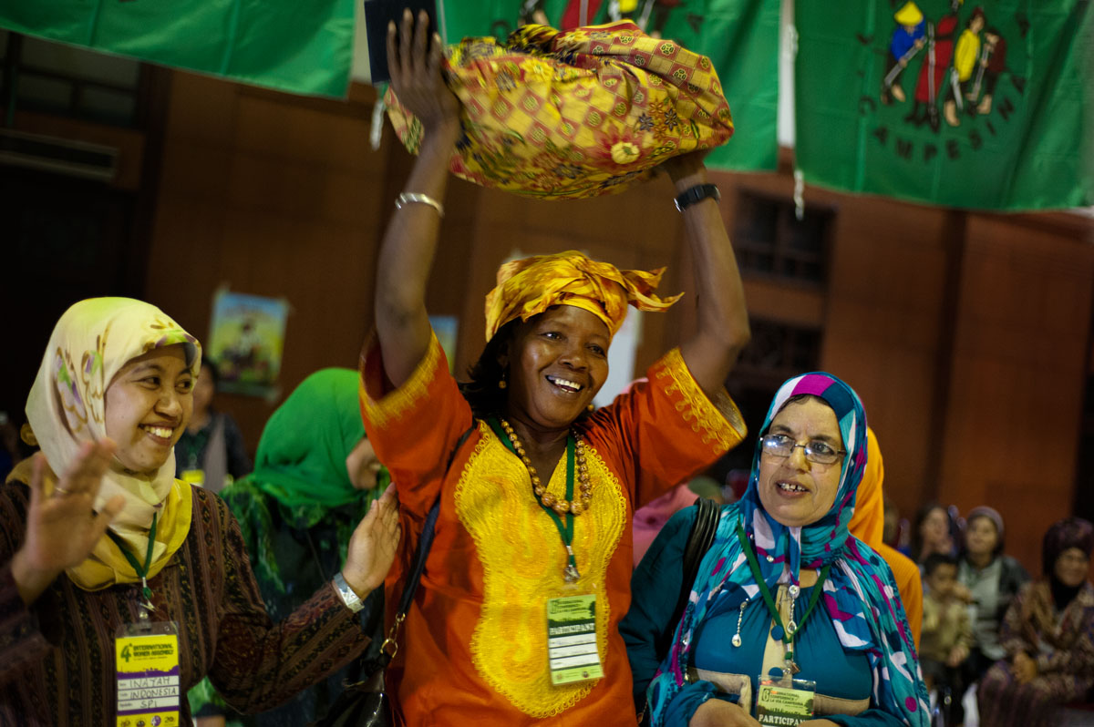
Definitions
5. Ending the Globalization of Hunger
… Regulation and taxation of speculative capital and a strictly enforced Code of Conduct.

Slide 26
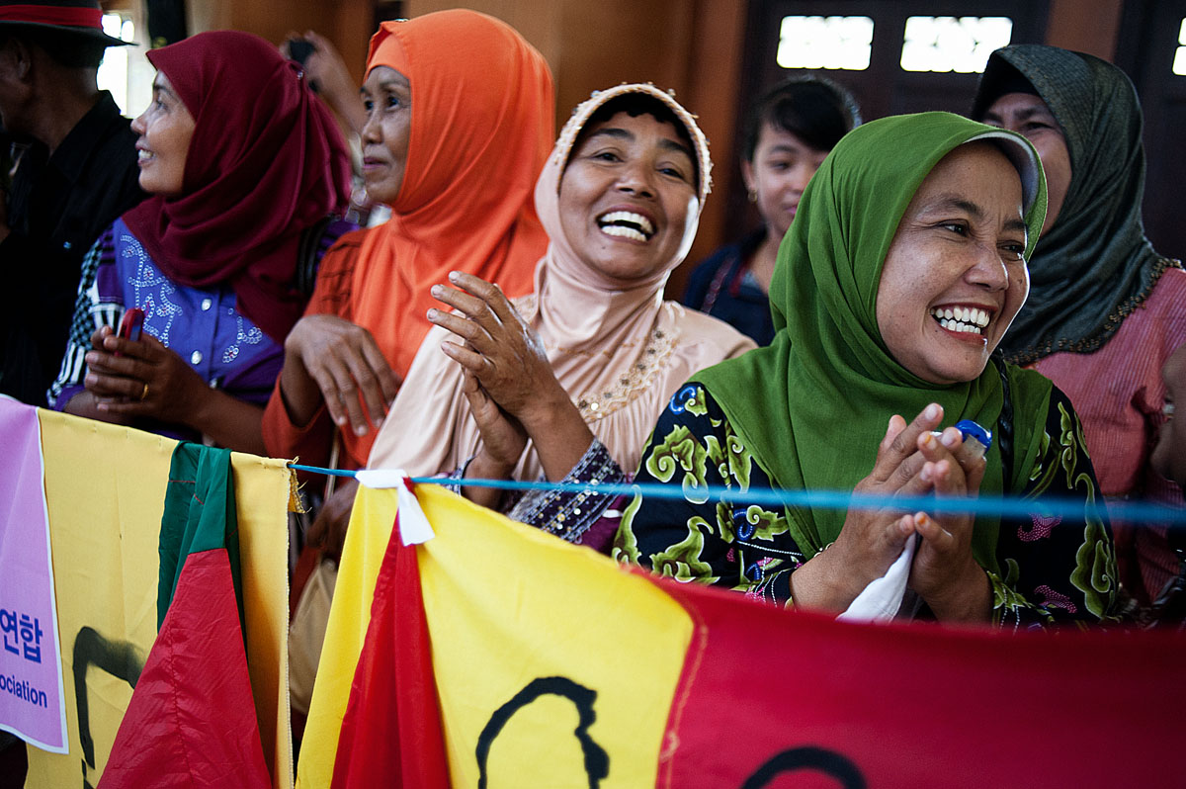
Definitions
Via Campesina’s Food Sovereignty Principles
www.viacampesina.org
6. Social Peace
Everyone has the right to be free from violence.

Slide 27
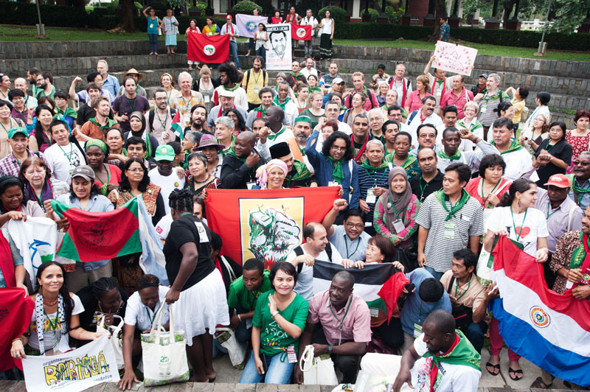
Definitions
Via Campesina’s Food Sovereignty Principles
www.viacampesina.org
7. Democratic control
… Everyone has the right to honest information and democratic
decision-making. https://vimeo.com/27473286

Slide 28
Week 2:
How the current food system came to be
and the injustices it promotes.
Reading Assignment:
Pertaining to today’s dialogue: pp. 11-15, 19-21, 85 & 88.
OKT Handouts: #2 What Is Food Justice? & # 3 Women of Color and Food Justice
Background for class 2: pp. 50 – 58, 62-67, 102 – 108, 126 – 137.
OKT Handouts: Just Food Dollars & #8 Food Justice & Public Health
If you’d like to make a tax-exempt donation to cover the costs of this series or for other OKT programs, please contact us at OKTable1@gmail.com.

